Slide 1
2025 Bank Franchise Tax
2025

Slide 2
Introduction
2
The Bank Franchise Tax (BFT) is an annual tax assessed on every incorporated bank, banking association, and savings bank in Virginia. The tax is based on the bank’s equity capital, and the tax due is split between the state and each locality with a banking location.
Starting with the 2025 filing year, the Bank Franchise return (Form 64 and Schedules) must be filed electronically.

Slide 3
New Process Overview

Slide 4
What is the BFT?
Overview
The tax rate is $1 for every $100 of taxable equity capital
  Prorated for new banks
  80% of tax liability allocated to localities based on deposit share
  20% of tax liability allocated to Virginia’s general fund
Liable banks are exempt from Virginia Corporate Tax and BPOL taxes

Slide 5
Timeline
Overview
Filing Due Date: March 1st
Automatic Filing Extension: May 1st
Payment Due Date: June 1st
  Banks pay the locality portion of tax due directly to their localities. Localities are responsible for their own billing if they choose to send an invoice.

Slide 6
New Process
Overview
Banks no longer mail copies of the Form 64 or Schedules to the localities.
Principal Localities (determined by location of first VA branch) will review and certify returns through IRMS Web.
The Schedule C (Assessed Value of Real Estate) and Schedule H (Local Tax Distribution) are sent through EESMC as a File Transfer to the non-principal localities with a banking location.
Localities are required to provide an updated SA-IRMS-E form requesting BFT permissions for IRMS Web and/or EESMC to view their information.

Slide 7
Receiving Return Information
Overview
  The Principal Locality receives an EESMC notification that a return is available in their IRMS Web worklist, along with a full transcript of the Form 64.
  Non-principal localities receive a Schedule C and/or Schedule H EESMC File Transfer if their FIPS code was listed on the schedule.

Slide 8
Reviewing Return Information
Overview
  The Principal Locality reviews the Schedule C information to the best of their ability, verifying that the assessed values are accurate and the property was listed in the correct locality.
  A return should be Approved in IRMS Web if there are no issues with the return and Rejected if there are any errors (incorrect values, calculation errors, etc.)
  If a return is rejected, the locality should reach out directly to the bank to let them know what corrections are needed.
  Returns should be reviewed within 20 days of filing.

Slide 9
Non-Principal Locality Review
Overview
  Non-principal localities should review their Schedule C information to verify that the assessed values in their locality are accurate.
  The Schedule H is reviewed to determine how much tax should be paid to their locality.
  If an assessment was incorrect, or reported in the wrong locality, they should reach out to the Principal Locality office to let them know that the return should be rejected.
  Schedules should be reviewed in a timely fashion.

Slide 10
Rejected and Amended Returns
Overview
  Rejected returns must be refiled after corrections are made.
  The submission date of the original return will be used to determine if a return was filed on time.
  Rejected and Amended returns will go through the same locality review process and generate new EESMC reports.

Slide 11
The Form 64

Slide 12
The Form 64 & Schedules
The Form 64
Deductions:
  Sch. E: US Obligations
  Sch. F: Retained Earnings
  Sch. J: Goodwill
  Sch. K: Intangible Asset Interest of Affiliates
Subtractions:
  Sch. C: Virginia Real Estate
  Sch. D: Personal Property
Sch. CR: Credit Schedule
Sch. H: Locality Taxes
    Locality tax apportionment
  Sch. L: Alternative Apportionment

Slide 13
Deductions
The Form 64
Capital for U.S. Obligations: A deduction for government obligations not taxable at the state or federal level. The deduction is determined by averaging the percentages of the income for U.S obligations by total assets for each quarter. The average percentage is multiplied by the bank’s gross capital.
Retained Earnings and Surplus of Subsidiaries: A deduction for the increase in the bank’s recorded investment of its subsidiaries resulting from undistributed earnings, limited to the amount included in the gross capital on the Call Report.

Slide 14
Deductions
The Form 64
Goodwill: Deduction of up to 90% of goodwill created in connection with the acquisition or merger of a bank on or after July 1, 2001.
Interest Related to Intangible Assets of Affiliates: A deduction of interest received from an affiliate in connection with the use of patents, trademarks, or similar property by the affiliate, provided the deduction was not taken on the affiliate’s corporate return, the interest that was added back was paid to the bank, and the interest has not otherwise been excluded from the bank’s gross capital.

Slide 15
Subtractions
The Form 64
Real Estate: A subtraction of the assessed value of real estate owned by the bank, or the assessed value of leasehold improvements owned by the bank if they do not own the property. Values are reported as of the most recent assessment made prior to January 1st.
Leased Tangible Personal Property: A subtraction of the book value of leased tangible personal property that is taxed at the local level and owned by the bank or a majority owned subsidiary. Leased vehicles qualify for the subtraction, however property used for administrative purposed does not. Property must be owned as of January 1st to qualify.

Slide 16
2025 Filing Season

Slide 17
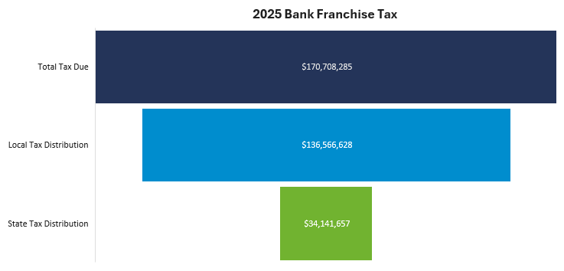
Filing Statistics
2025 Filing Season
224 localities will receive a portion of the Local Tax distribution.
There are 116 BFT taxpayers and approximately 1,800 individual bank branches in Virginia.

Slide 18
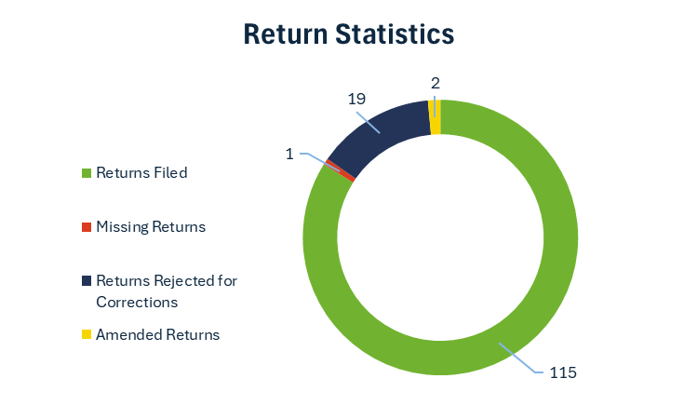
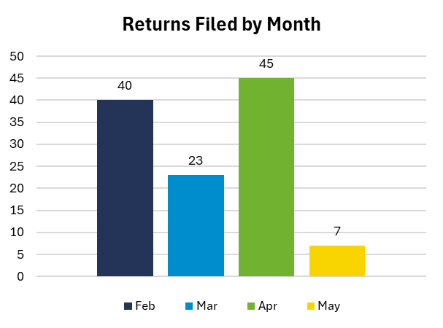
Filing Statistics
2025 Filing Season
115 of the expected 116 returns were received.
Of those 115 returns, 19 were rejected for corrections. The most common rejection reason was for incorrect Real Property Assessment Values.
65% of filers elected to take the automatic May 1st filing extension.

Slide 19
Contact Information
19
Jeremy Armstrong
Patricia Thurston
Locality Liaison
BFT Unit Supervisor
Jeremy.Armstrong@tax.virginia.gov
Patricia.Thurston@tax.virginia.gov
BFT Unit Hotline
Fax
804.404.4215
804.786.2645

Slide 20

Thank You!
Patricia Thurston
Team Supervisor
patricia.thurston@tax.virginia.gov

