Slide 1
Introduction to VDACS Office of Hemp Enforcement (OHE)
1

Slide 2

OHE Overview
Purpose: Serve and protect the citizens of Virginia by ensuring the safety of Edible Hemp Products (EHPs) that are made, distributed, or offered for sale in Virginia. This is done by upholding compliance to The Virginia Food and Drink Law.
Action: We are currently conducting Edible Hemp Product inspections throughout the Commonwealth.
2

Slide 3
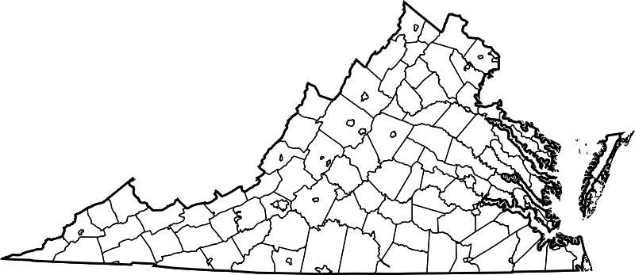
OHE Staffing
Fauquier
Prince William
Rockingham
Fredericksburg
Lynchburg
Richmond (HQ)
Williamsburg
Wythe
VA Beach
3
Notes:
This map depicts the approximate locations for our field positions, as well as the Richmond Headquarters. The inspector locations are Wythe, Lynchburg, Rockingham, Fauquier, Prince William, Fredericksburg, Williamsburg, and VA Beach with the supervisor being convenient to Richmond, where the office positions are based. You may notice that the territories are not evenly spaced and are not all the same size because each area has a different density of hemp businesses and the inspectors are dispersed, accordingly.

Slide 4
OHE Staffing
Field
Positions:
8 Inspectors are strategically spread throughout the state to provide appropriate coverage to all territories.
1 Inspection supervisor located convenient to Richmond headquarters.
Richmond Office:
1 Program Manager
3 Compliance and Technical Specialist
1 Administrative Support Technician
1 Registration Specialist
1 Compliance & Technical Specialist Supervisor
4
Notes:
Our office has 15 total positions and currently 11 positions are filled. (We are still working to fill the VA beach and Wythe territory inspection positions, as well as the inspection supervisor and the OHE administrative coordinator positions.)

Slide 5


Field Inspector Job Duties
Conduct onsite inspections for all businesses carrying EHPs. (These may be conducted as a routine inspection or as part of a complaint investigation.)
  Gather business information and take photographs of all EHPs onsite.
  Provide handouts outlining the requirements to sell EHPs in Virginia and contact information for our office.
  Review facility conditions and evaluate other retail food safety requirements.
Create label-review documents, gather certificates of analysis, and conduct a preliminary review for each inspected EHP.
Compile inspection information and label-review documents to submit to the compliance team.
5

Slide 6


Compliance Job Duties
Review inspection reports
Act as the technical experts of our office, with knowledge of both hemp product law and hemp plant chemistry.
  Answer questions (from inspectors, businesses under inspection, and the public) regarding hemp extracts, hemp product ingredients, hemp product labeling, and certificates of analyses.
Handle compliance activities to include finalizing product reviews, sending Notices of Alleged Violation and Penalty Assessments, and building the cases for formal hearings or informal fact-finding conferences.
6

Slide 7



What is a hemp product?
"Hemp product" means a product, including any raw materials from industrial hemp that are used for or added to a food or beverage , that
  (i) contains industrial hemp and has completed all stages of processing needed for the product and
  (ii) when offered for retail sale
    (a) contains a total tetrahydrocannabinol concentration of no greater than 0.3 percent.
    (b) contains either no more than two milligrams of total tetrahydrocannabinol per package or an amount of cannabidiol that is no less than 25 times greater than the amount of total tetrahydrocannabinol per package.

Slide 8
What is an EHP?
"Edible hemp product" means any hemp product that is or includes an industrial hemp extract and that is intended to be consumed orally. "Regulated hemp product" means a hemp product intended for smoking or an edible hemp product
Examples: gummies, cookies, candies, tinctures, oils, and dietary supplements (pills/tablets/capsules)

Slide 9
The Virginia Food and Drink Law
The law we are enforcing, The Virginia Food and Drink Law, was updated July 1, 2023, to include:
Limiting the amount of THC in food products to 2 mg of THC per package, or when there is more than 2 mg, there must be 25 mg of CBD for every 1 mg of THC. (25:1 ratio)
Edible hemp products that contain THC must be in child-resistant packaging.
Edible hemp products must bear a label with specific information and be accompanied by a certificate of analysis produced by an independent, ISO 17025 accredited laboratory.
9

Slide 10
The Virginia Food and Drink Law
“Total THC” means all the THC in a product, including delta-8 and delta-9 THC. (Total THC must be <0.3%.)
Anyone planning to sell or produce orally consumed substances that contain an industrial hemp-derived cannabinoid must submit an Edible Hemp Products Disclosure Form.
A VDACS Food Permit may be required to sell these products unless the retail establishment is exempt. A Food Permit is required to manufacture food products OR an exemption form is required for facilities that meet the appropriate criteria.
Enacted civil penalties of up to $10,000 per violation of the Food and Drink Law.
10

Slide 11
Purpose of Edible Hemp Products (EHP) Inspections
Primary purpose: Enforcement of the law to uphold product safety and protect Virginia’s consumers.
Evaluate Edible Hemp Products offered for sale by retailers, distributors (wholesalers), and manufacturers for compliance with the requirements of the law.
Education on the laws is secondary to the primary focus of enforcement for these inspections. Inspectors provide basic information, resources, and contact information to help answer questions. Compliance staff help with education and interpretation of requirements.
11

Slide 12
Requirements: 3.2-5145.4:1
"Child-resistant" means, with respect to packaging or a container, (i) specially designed or constructed to be significantly difficult for a typical child under five years of age to open and not to be significantly difficult for a typical adult to open and reseal and (ii) for any product intended for more than a single use or that contains multiple servings, resealable.
All products offered for sale must be from an approved source. A manufacturer of an industrial hemp extract or food containing an industrial hemp extract shall be an approved source if the manufacturer operates:
1) under inspection by the responsible food regulatory agency in the location in which such manufacturing occurs;
2) in compliance with the laws, regulations, or criteria that pertain to the manufacturer of industrial hemp extracts or food containing an industrial hemp extract in the location in which such manufacturing occurs.

Slide 13
Labeling Requirements
An edible hemp product offered for sale must be equipped with a label that has the following information:
  All ingredients contained in the substance.
  The amount of such substance that constitutes a single serving.
  The total percentage and milligrams of all tetrahydrocannabinols included in the substance.
  The total number of milligrams of all tetrahydrocannabinols that are contained in each serving.
  If the substance contains tetrahydrocannabinol, that the product contains tetrahydrocannabinol and may not be sold to persons younger than 21 years of age.
Selling or offering for sale any substance intended for human consumption, orally or by inhalation, that contains a synthetic derivative of tetrahydrocannabinol is a prohibited act.

Slide 14
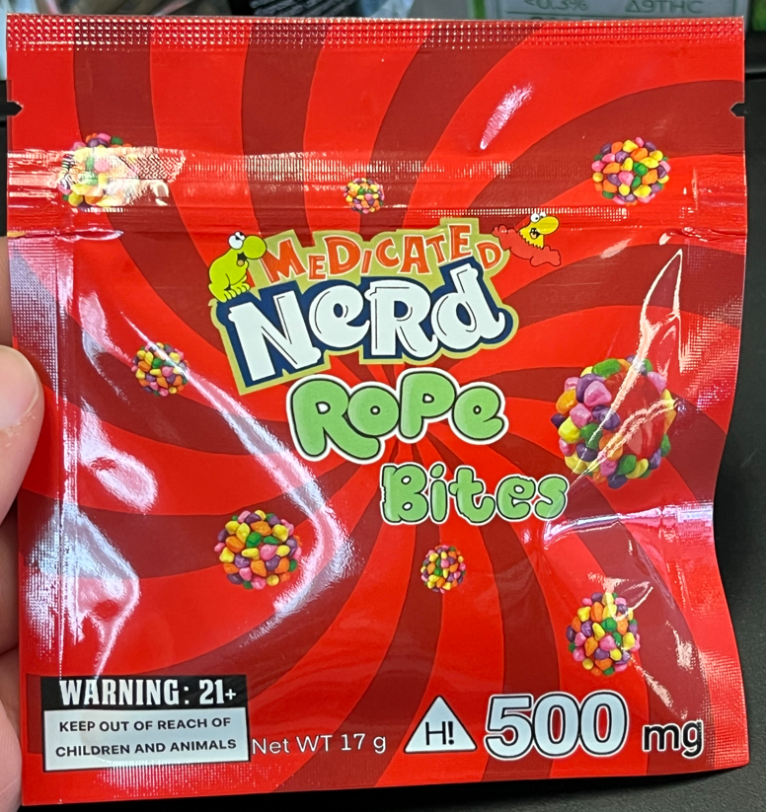
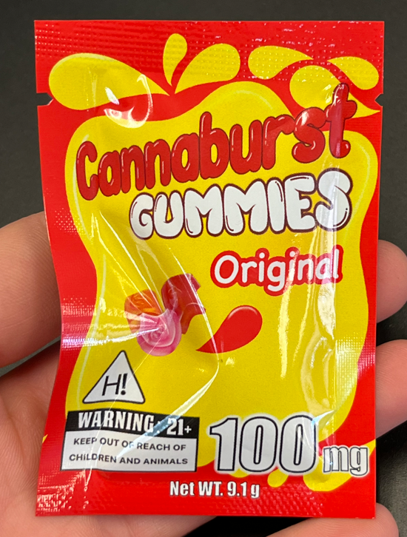
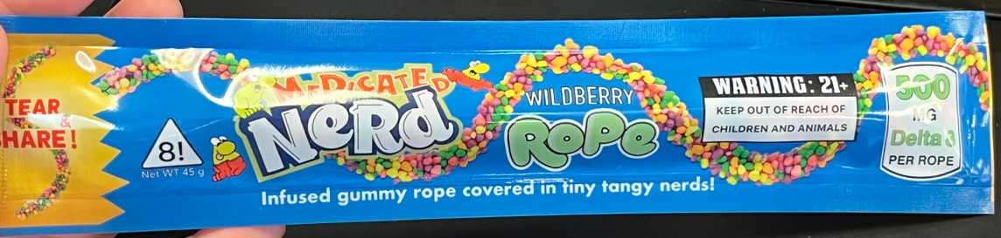
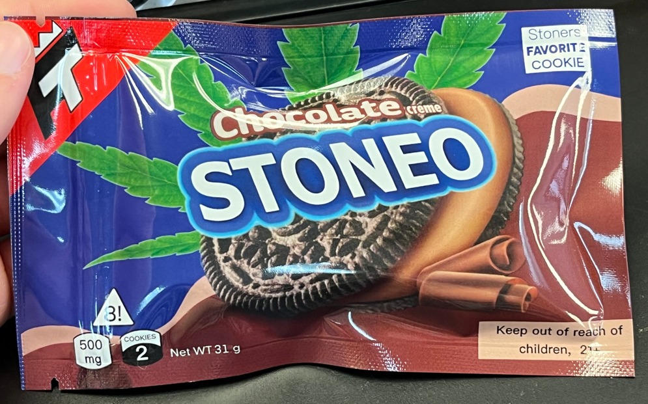
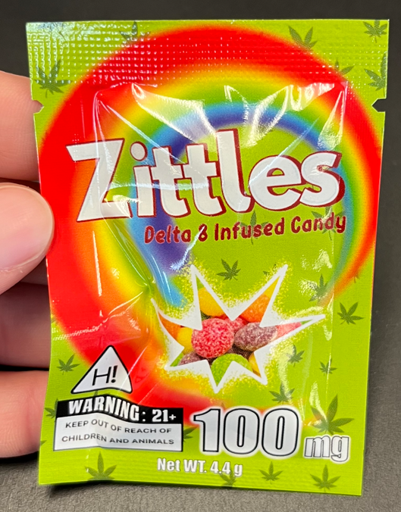
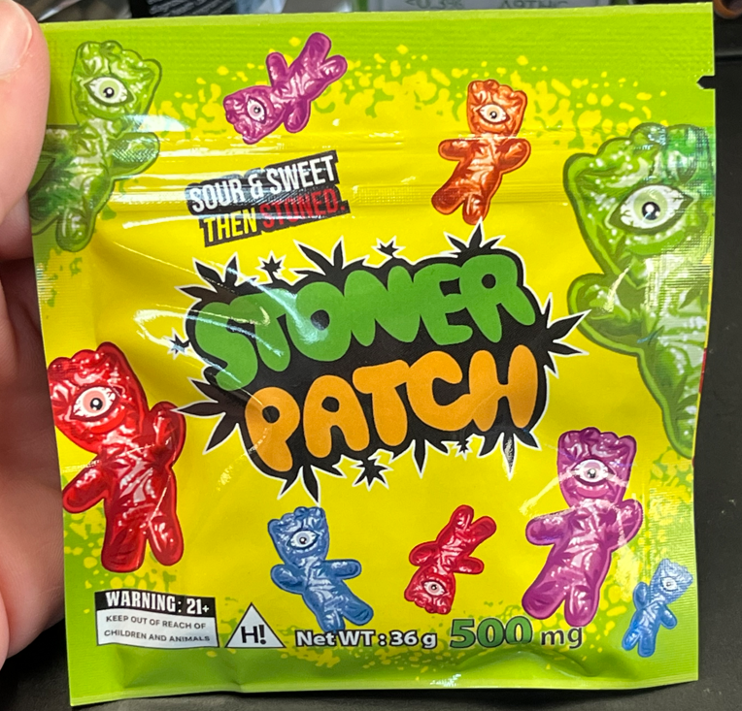
Non-Compliant Product Examples – Fraudulent Packaging
14
Notes:
Virginia Code: If the product contains THC, the packaging/labeling does NOT bear any significant likeness to another manufacturer’s product. § 3.2-5145.2:1(D); § 59.1-200(A)(73)
From a show of hands, who in this audience has seen candy or cookies at the grocery store, that at first glance look like these products?
From a show of hands, who in this audience has young children in your family? This may be a child, niece, nephew, grandchild, or even a close friend that feels like family.
Okay, so now imagine if the kids in your family saw these products, at home or at school. Do you think young children who can’t read would think twice about consuming them? No, it is very unlikely they would notice a difference or think twice about it. My brother is an EMT in the Charlottesville area and has seen firsthand, that children end up in the emergency room because of these type of products.
These products pose a high risk to children because of their marketing and because they contain high doses of synthetic derivatives. We are working to protect Virginia’s citizens and especially Virginia’s youth, by removing these type of products from VA commerce. We are also working to ensure child safety by upholding other labeling/packaging requirements that will make the product labels less appealing to children and make the products harder for kids to open.

Slide 15
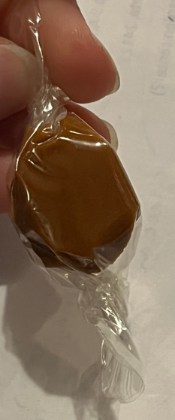
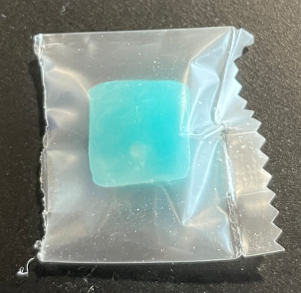
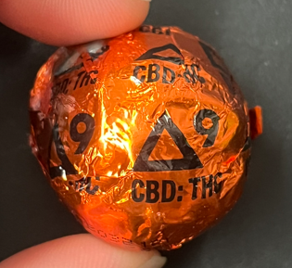
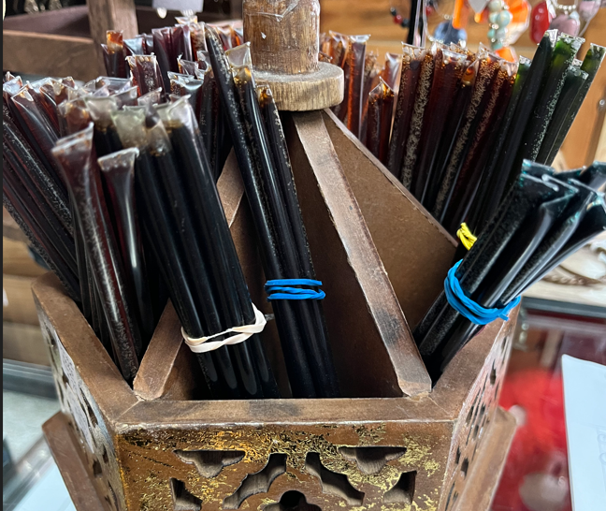
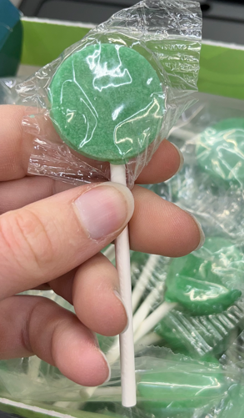
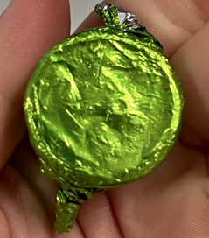
Non-Compliant Product Examples –
No Statement of Identity or Appropriate Labeling
15
Notes:
The products above all contain THC and/or CBD. However, only one of the products has markings to denote that, and the one that does, does not declare an amount of the cannabinoids. The others you would have no idea they aren’t standard candy/honey sticks.
So, from the participation on the last slide, we know that most people in here have a child in their family that they care about. Now imagine this child reaching into someone’s purse or cabinet and seeing one of the products above. If a kid pulled an unlabeled caramel candy or an unlabeled lollipop from a family member’s purse, are they going to eat it? Chances are, yes. I know I would. Unlabeled or not sufficiently labeled products also pose a risk to Virginia’s public and we are working to remove these products from VA commerce by upholding all labeling standards. Consumers should be informed about what they are purchasing and ingesting, and the products they buy must be fully labeled to ensure that.

Slide 16
Common Myths
Search Warrants are not required for VDACS inspection purposes: The Commissioner or designee (VDACS inspector) will be allowed to enter this location that the regulated hemp product is offered for sale and inspect the entire premises including, areas designated for storage, display, or restricted to employees to ensure compliance with the requirements of Code of Virginia, Chapter 41.1 (Article 4 § 3.2-4122 et seq.)
VDACS wants to shut down my business: VDACS has an objective to protect consumers from harmful products by providing regulatory oversight of regulated hemp products. Registry of compliant products that is updated frequently- https://www.vdacs.virginia.gov/pdf/ohe_voluntary_registry.pdf
VDACS works with law enforcement: VDACS has no involvement with police or criminal matters.

Slide 17

Hemp Product Retail Facility Registration
Notable requirements to be aware of include but are not limited to:
A regulated hemp product retail facility registration shall be required for each location that offers for sale or sells at retail regulated hemp products.
As required by law, a nonrefundable annual registration fee of $1,000 shall be required with each application for a regulated hemp product retail facility registration.
Each registration issued shall be valid for a period of one year from the date of issuance and may be renewed in successive years. Each annual renewal shall require the payment of the nonrefundable annual registration fee.
Applications will be available on November 15, 2024. Registrations will be issued in the order in which the application was received, and applicants will receive confirmation once an application and fee has been properly verified by VDACS Office of Hemp Enforcement.

Slide 18
Contact Information
OHE General Contact:
  Email: hempenforcement@vdacs.virginia.gov
  Phone: 804-786-1382
Nikeya Thomas – Program Manager:
  Nikeya.Thomas@vdacs.virginia.gov
18

Slide 19
Thank you!
19

